Slide 1
Rockbuster Stealth
Objective
To develop a launch strategy for the new online video service. Project brief can be found here.
Data Set
The data set contains information about Rockbuster's film inventory, customers, and payments, among other things.
Rockbuster data set can be found here.
Data dictionary can be found here.
Tools and Procedures
Relational databases
SQL
Database querying
Filtering
Cleaning and summarizing
Joining tables
Subqueries
Common table expressions

Slide 2
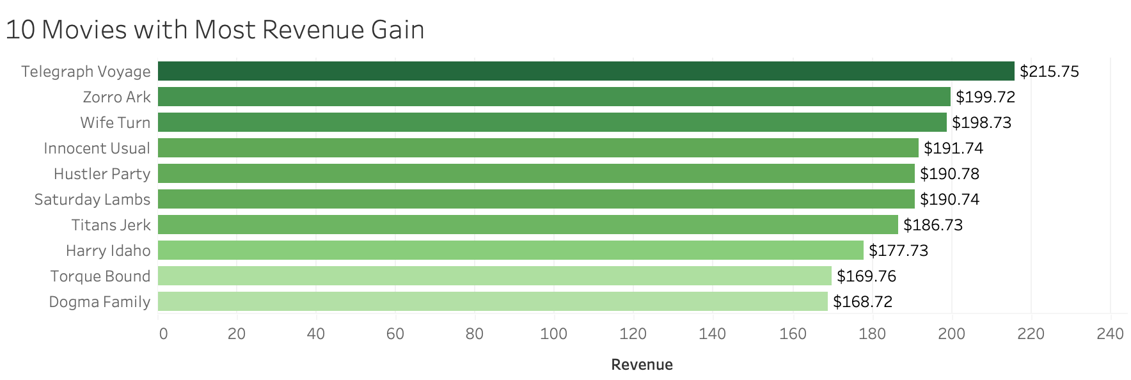
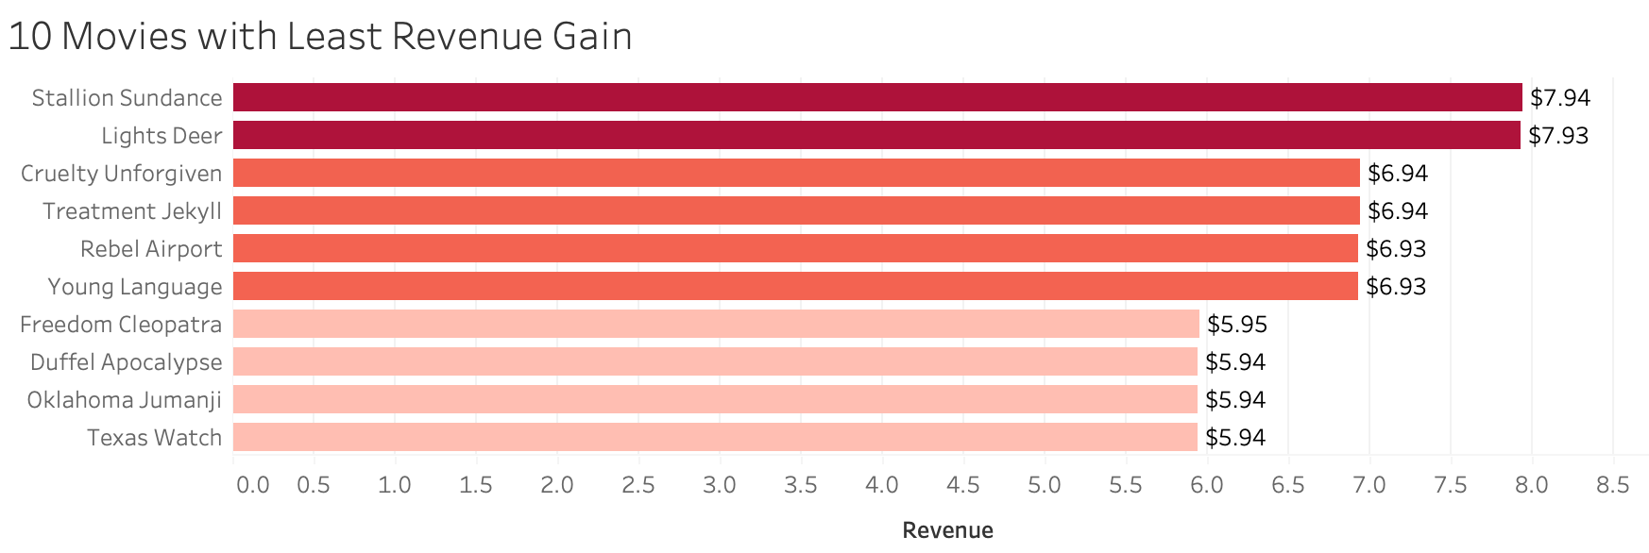
ANALYSIS
Which movies contributed the most/least to revenue gain?
Telegraph Voyage is the top-selling film with $215.75 in revenue.
Duffel Apocalypse, Oklahoma Jumanji, and Texas Watch are the lowest revenue films with $5.94.

Slide 3
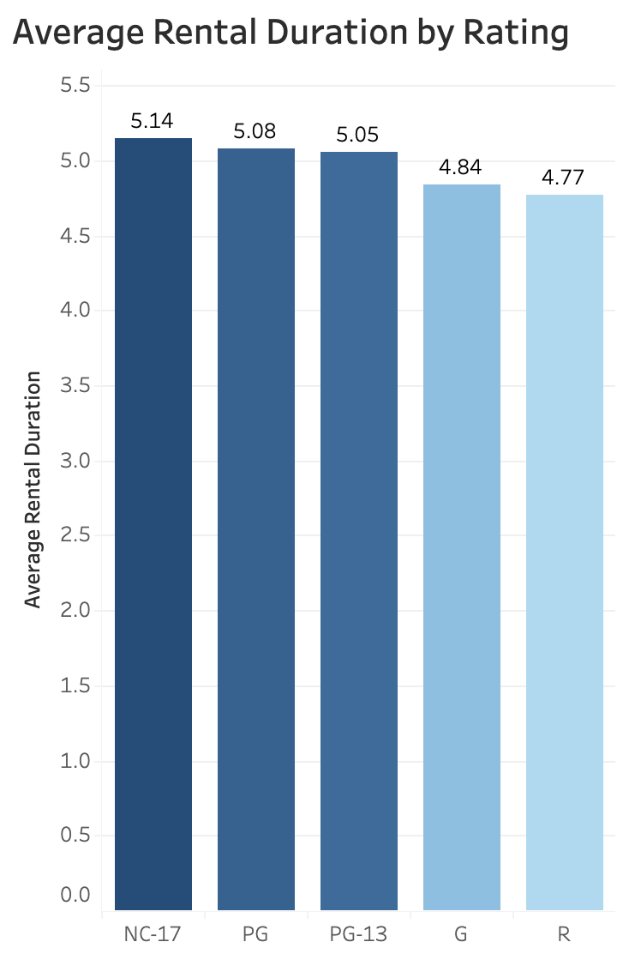
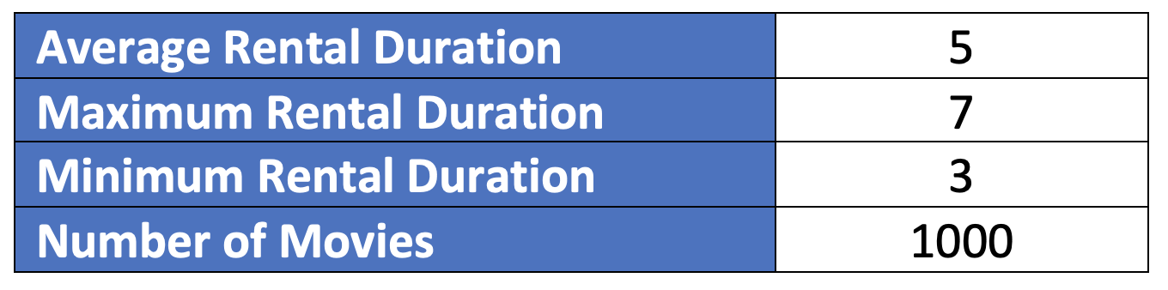
ANALYSIS
What was the average rental duration for all videos?
Average rental duration is 5 days
Maximum rental duration is 7 days
Minimum rental duration is 3 days
NC-17 is the top rating in rental duration with 5.14
R is the lowest rating in rental duration with 4.77

Slide 4
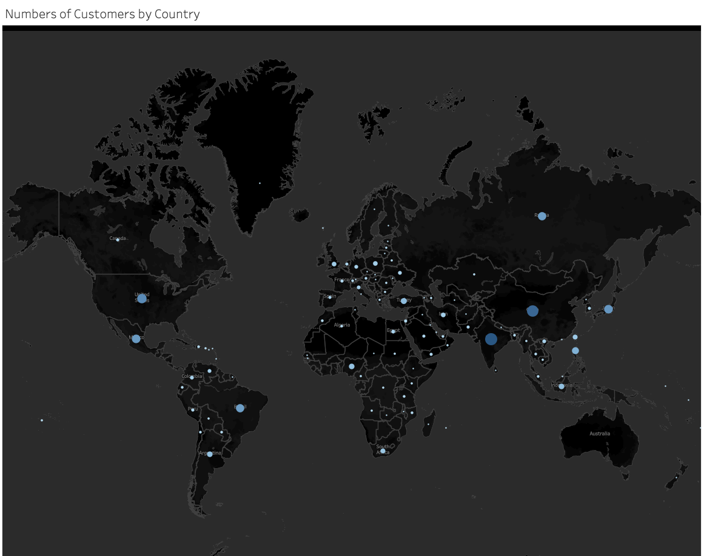
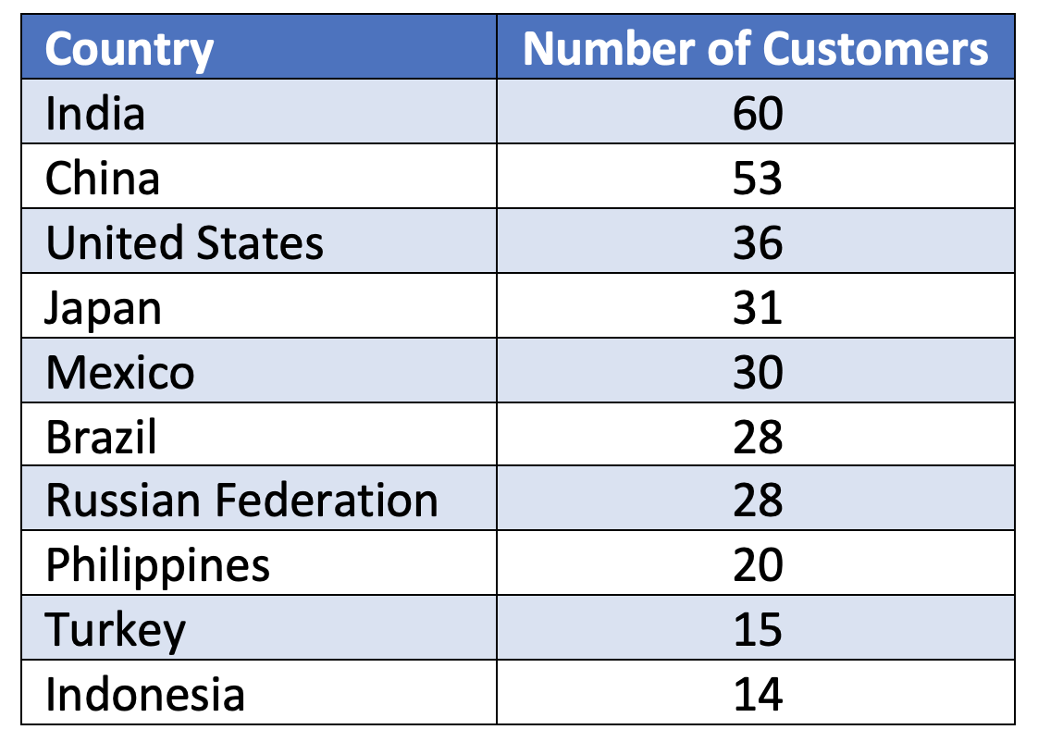
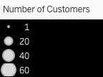
Which countries are Rockbuster customers based in?
Rockbuster customers are based in 108 countries.
The top 5 countries with the highest number of customers: India, China, United States, Japan, and Mexico.

Slide 5
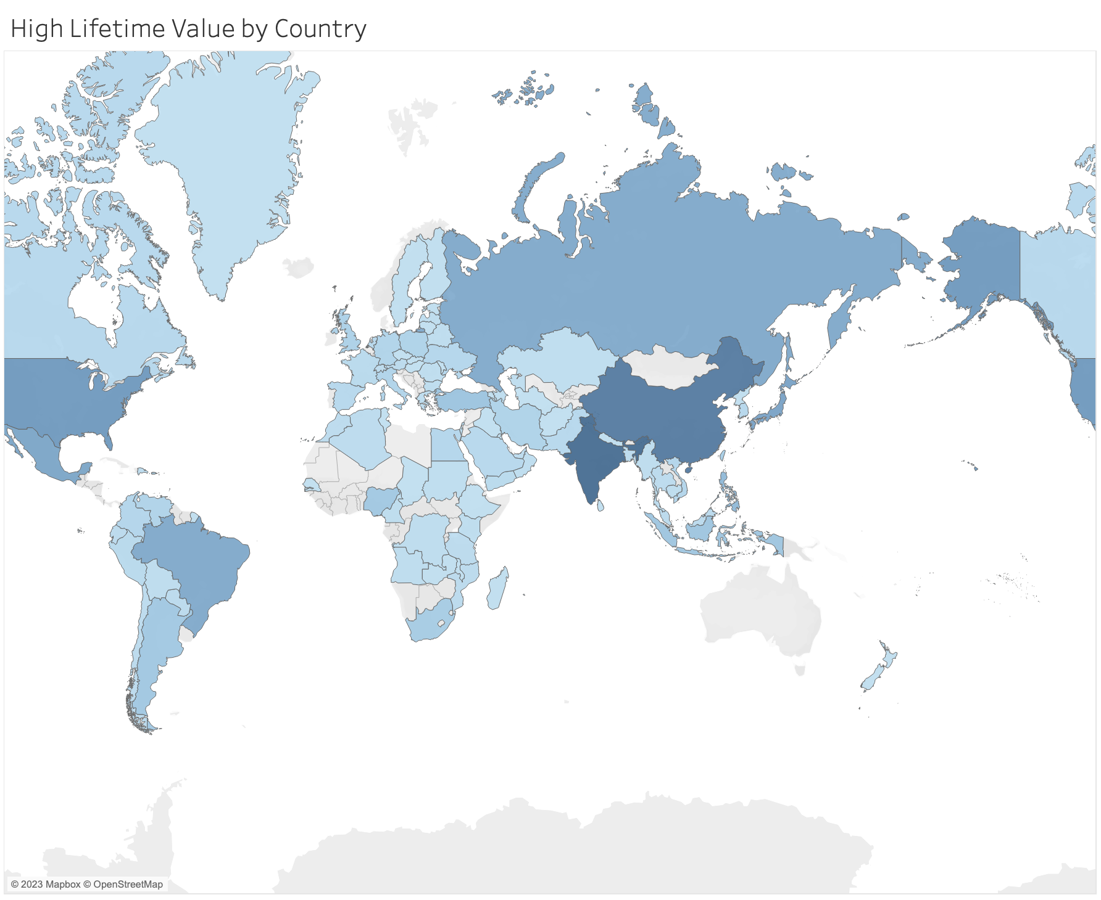
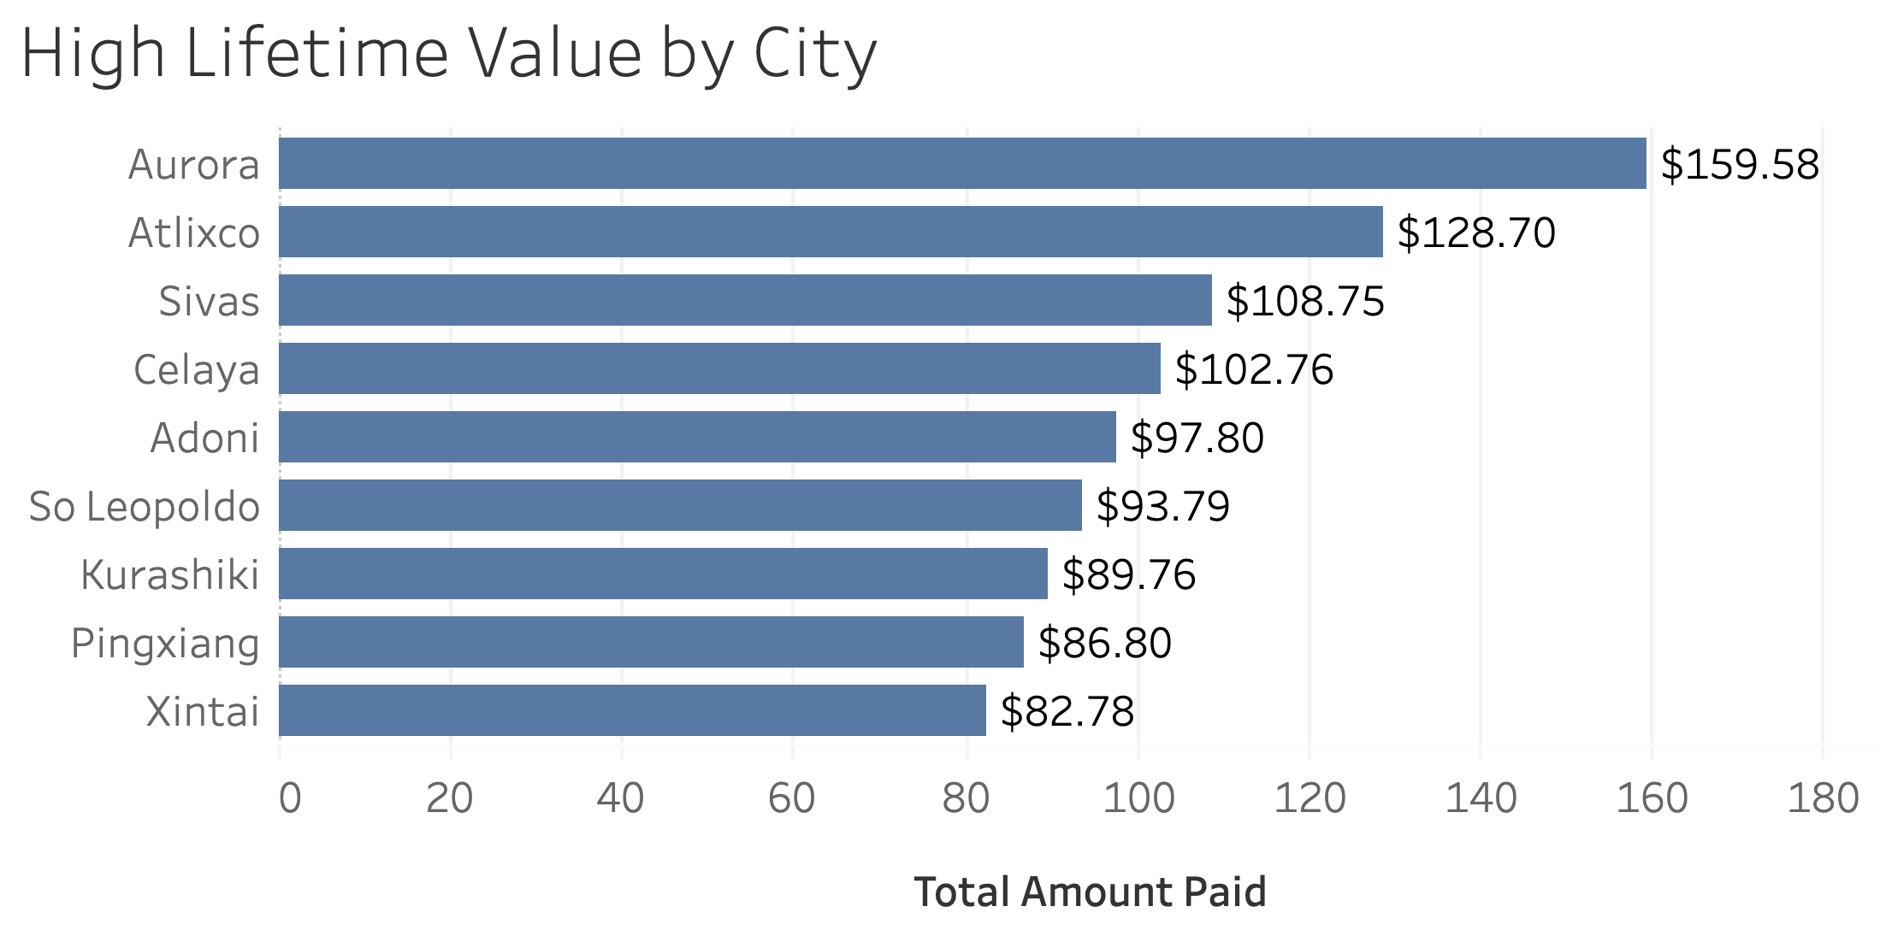
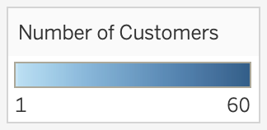
Where are customers with a high lifetime value based?
The top 5 cities of customers with high lifetime value: Aurora, Atlixco, Sivas, Celaya, and Adoni.

Slide 6
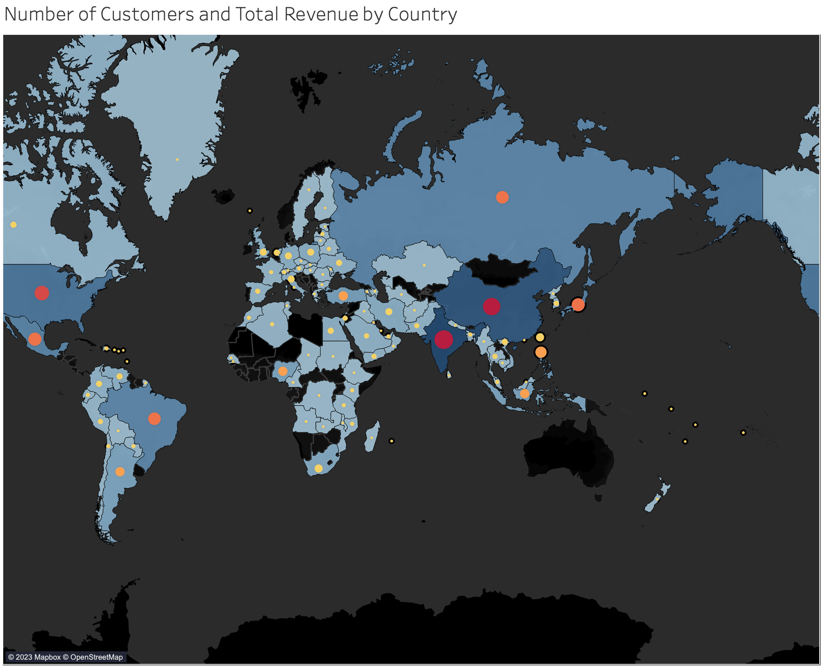
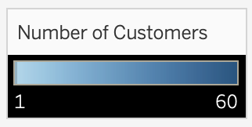
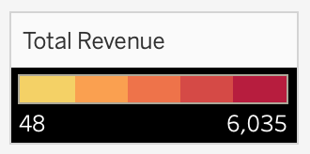
Do sales figures vary between geographic regions?
Yes, based on the shaded colors and circle sizes, countries with the highest number of customers generate the most revenue.

Slide 7



Recommendations
Rockbuster has negative film revenues that have not surpassed $10. It is recommended Rockbuster investigate the reason behind the low revenue for these movies.
Countries with the highest number of customers should be rewarded for their loyalty with special promotions.

